Slide 1






VOICE CONTROL
ROBOT
THOMAS A (URK22CO2021)
VISHOK S(URK22CO2019)

Slide 2
CONTENTS
Introduction
Problem Statement
Project Scope
Components
Methodology
Block Diagram
Project Output

Slide 3

INTRODUCTION
The Voice-Controlled Robot project aims to develop a robot that can be controlled using voice commands. The robot will be equipped with speech recognition capabilities to understand and interpret user commands, allowing for intuitive and hands-free control.

Slide 4



PROBLEM STATEMENT
Many individuals with disabilities face significant challenges in performing daily tasks independently due to mobility.
There is a pressing need for an accessible and user-friendly voice-controlled robot that can assist these individuals in various aspects of their daily lives, such as mobility, communication, and task execution.
This project aims to develop a reliable, affordable, and adaptable voice-controlled robot solution to address these specific needs and improve the quality of life for people with disabilities.

Slide 5


PROJECT SCOPE
The scope of this project is to develop a voice-controlled robot that empowers individuals with disabilities by providing them with a user-friendly, accessible, and adaptable tool to enhance their mobility, communication, and daily task management.

Slide 6

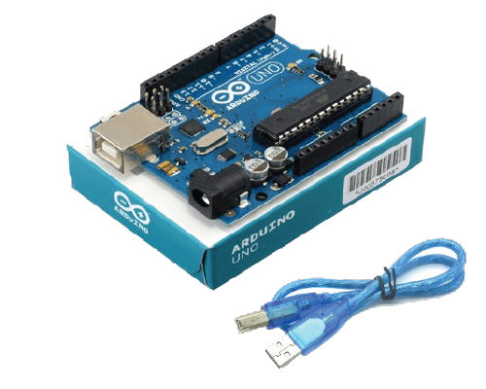
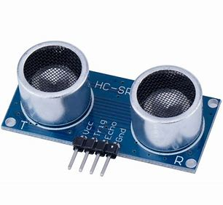
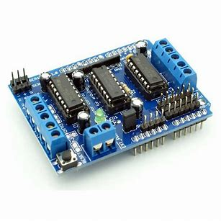


COMPONENTS
ARDUINO UNO
ULTRASONIC SENSOR
MOTOR DRIVER
The brain of the robot, responsible for processing commands.
Interfaces with sensors, motors, and the Bluetooth module to execute voice commands.
Interfaces between Arduino and the gear motor.
Allows the Arduino to control the motor's speed and direction.
Measures distance to detect obstacles.
Helps the robot avoid collisions by providing input to the control system.

Slide 7

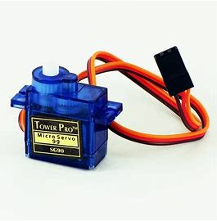


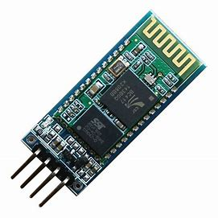
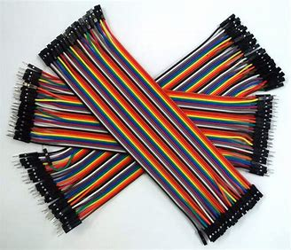


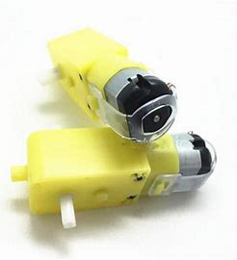

GEAR MOTOR
Used for locomotion, driving the robot's wheels or tracks.
Provides motion and control for the robot's movement.
SERVO MOTOR
Typically used for controlling robot arms, sensors, or cameras.
JUMPER WIRE
Connect various components on the breadboard or circuit.
Facilitate electrical connections in our project.
BLUETOOTH MODULE
Enables wireless communication with your robot.
Can be used to receive voice commands from a paired device (like a smartphone).

Slide 8


METHODOLOGY
In our voice-controlled robot project, we're assembling a robot with essential components like Arduino UNO, Bluetooth module, servo motor, gear motors, ultrasonic sensor, and Li-ion batteries. Our goal is to enable voice commands via Google Assistant.
We start by building the hardware, attaching wheels to gear motors, and powering it with Li-ion batteries. Wireless control is established through the Bluetooth module and precise motor control using the L293D motor driver. The ultrasonic sensor helps with obstacle detection.
To interact with the robot, we utilize Google Assistant and a Bluetooth app, with Arduino IDE for programming. In essence, our project integrates hardware, wireless communication, and voice recognition to create an interactive voice-controlled robot

Slide 9


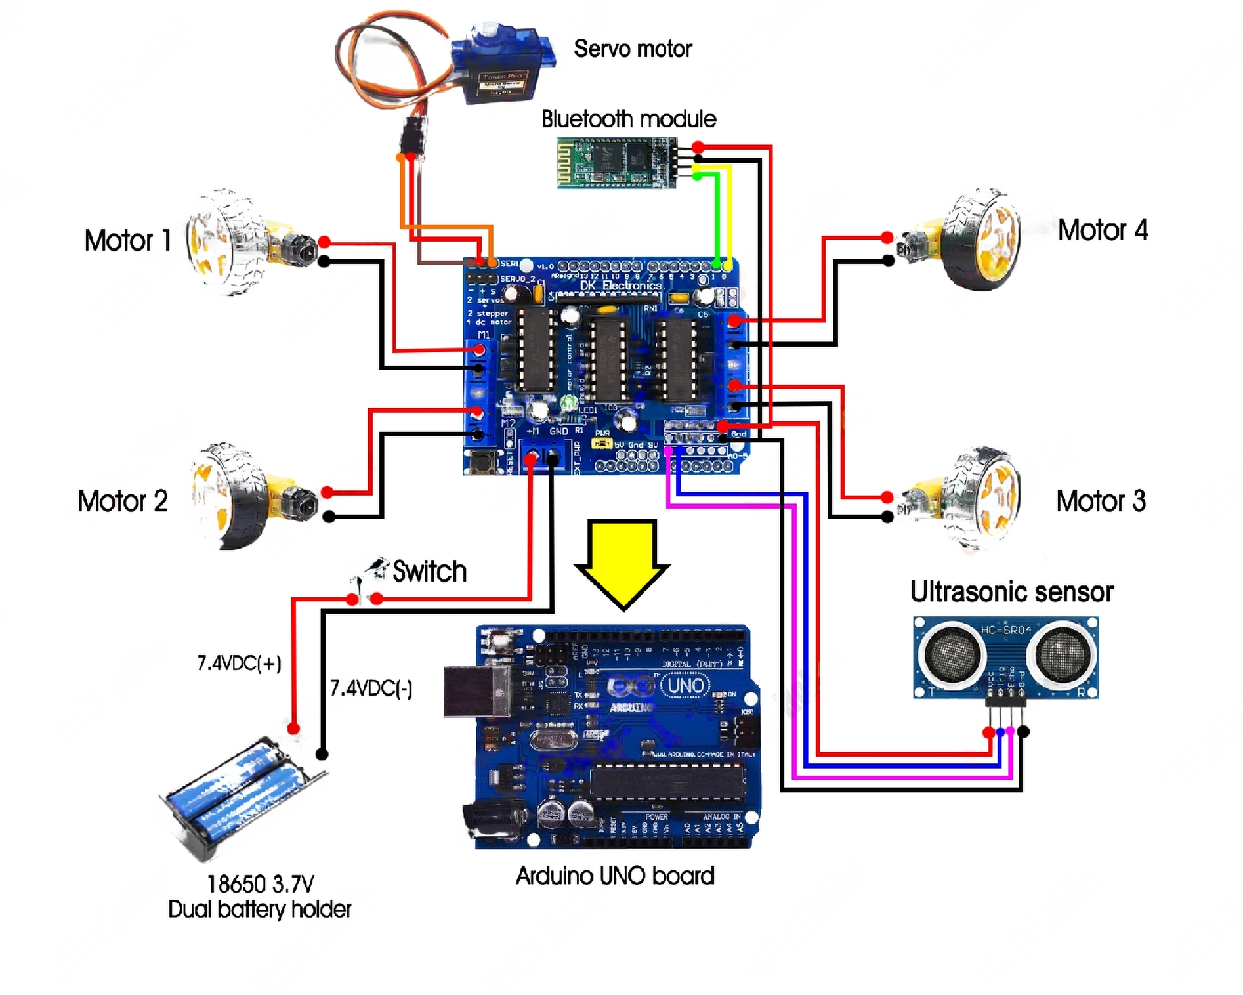

BLOCK DIAGRAM

Slide 10
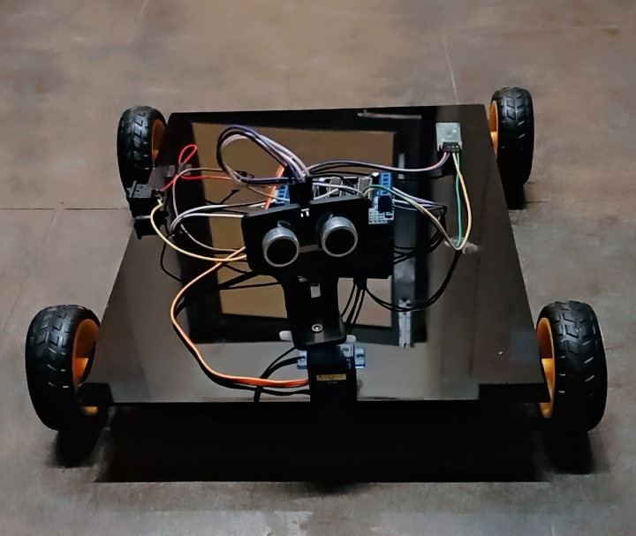
PROJECT OUTPUT

Slide 11

THANK YOU!

